Slide 1
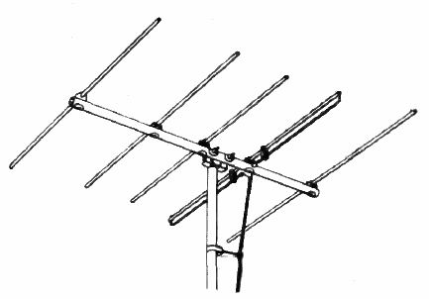
The Yagi Antenna: Design and History
Presented to
IEEE Life Member Group, Austin Chapter
IEEE Central Texas Section
by
Tom O’Brien, Life Senior Member, IEEE

Slide 2

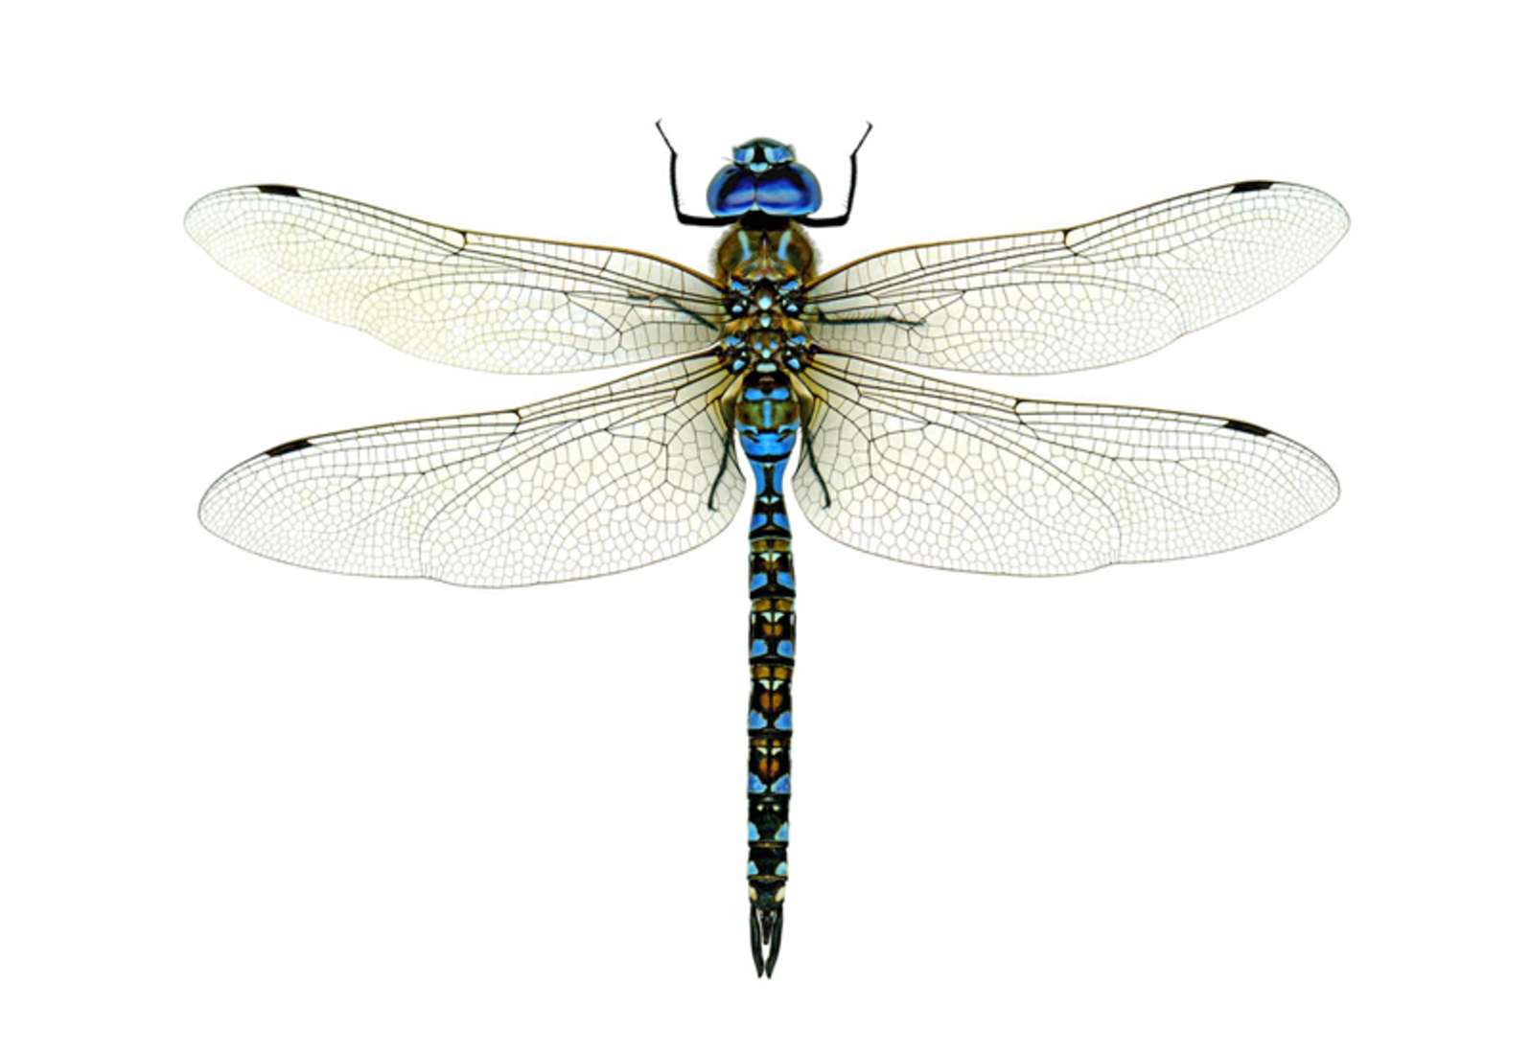
Which is it?
Yagi-Uda Antenna
Dragonfly?
Fish bone?

Slide 3
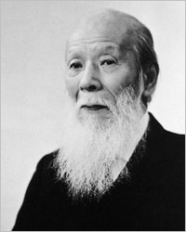
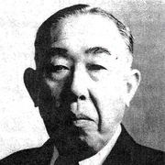
Yagi-Uda Antenna
Invented in Japan ~1926
Hidetsugu Yagi (January 28, 1886 – January 19, 1976)
Shintaro Uda (June 1, 1896 – August 18, 1976)
Tohoku Imperial University

Slide 4
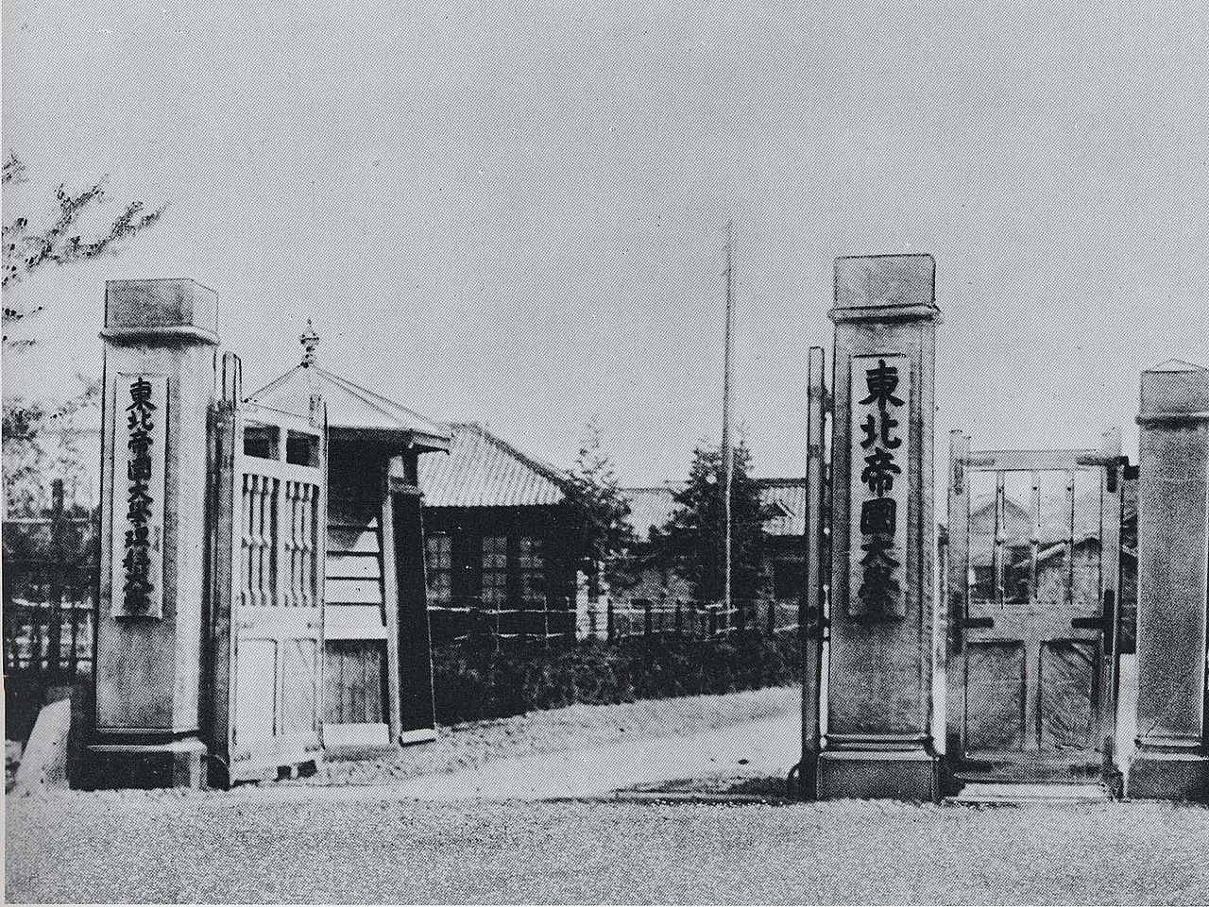
1926 US Patent
Uda was Yagi’s supervisor at Tohoku University*
Yagi submitted a patent application and a research paper under his own name.
* Founded 1907, one of seven Imperial Universities. These former Imperial Universities are generally perceived as Japan’s equivalent of the Ivy League in the U.S. and the Golden Triangle in the U.K.
Tohoku Imperial University in 1913

Slide 5
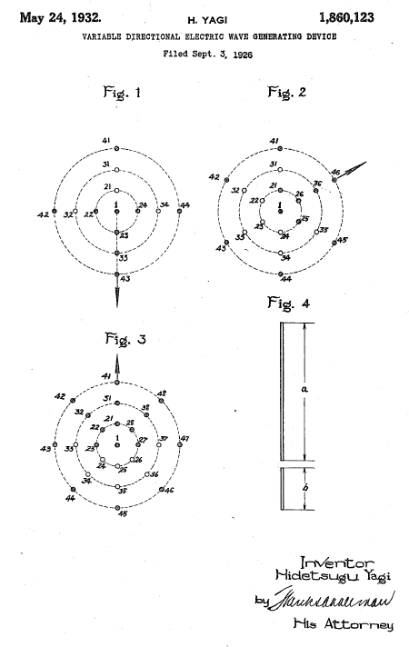
1926 US Patent
The drawing is not as obvious as other, later illustrations.
But the claims are right on (directionality, beam forming).
Filing date 1926, grant date 1932

Slide 6
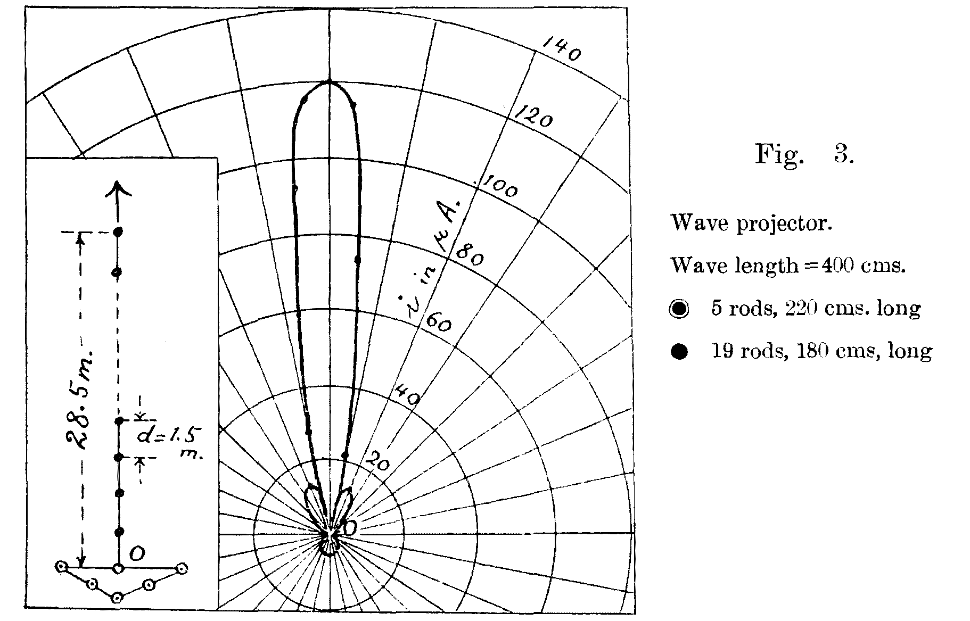
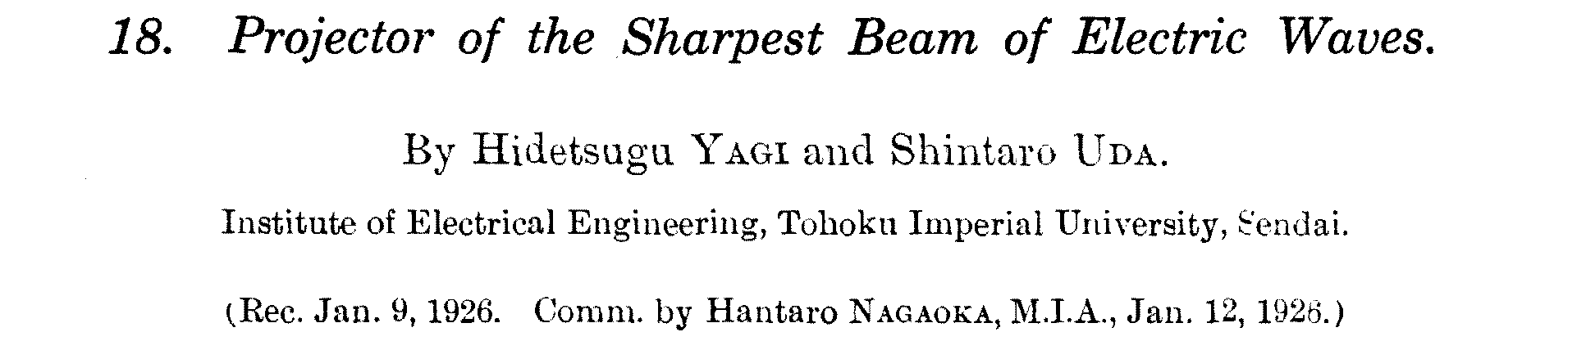
1930 paper
Content similar to the patent language
The illustrations get the point across very well.

Slide 7
Allies used the invention in radar
Germany used the invention to lesser extent.
Japan made some use of the Yagi antenna in airborne radar, late in World War II.
One Japanese historian says that the Battle of Midway was an “ambush” partly due to the long-range radar enabled by the Yagi antenna.
Japanese captured a tech manual on a British searchlight guidance system but didn’t understand the English idiom.
Germany gave Japan a “Wurzburg” radar as used in Normandy.

Slide 8
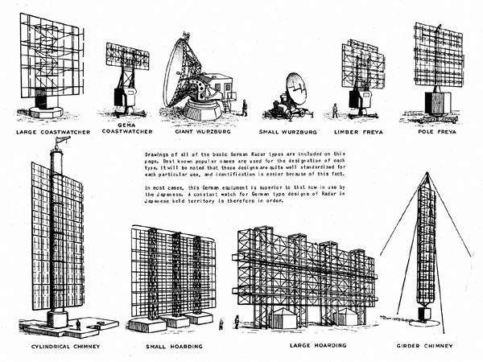
German radar antennas
Described in “Most Secret War” by R. V. Jones

Slide 9
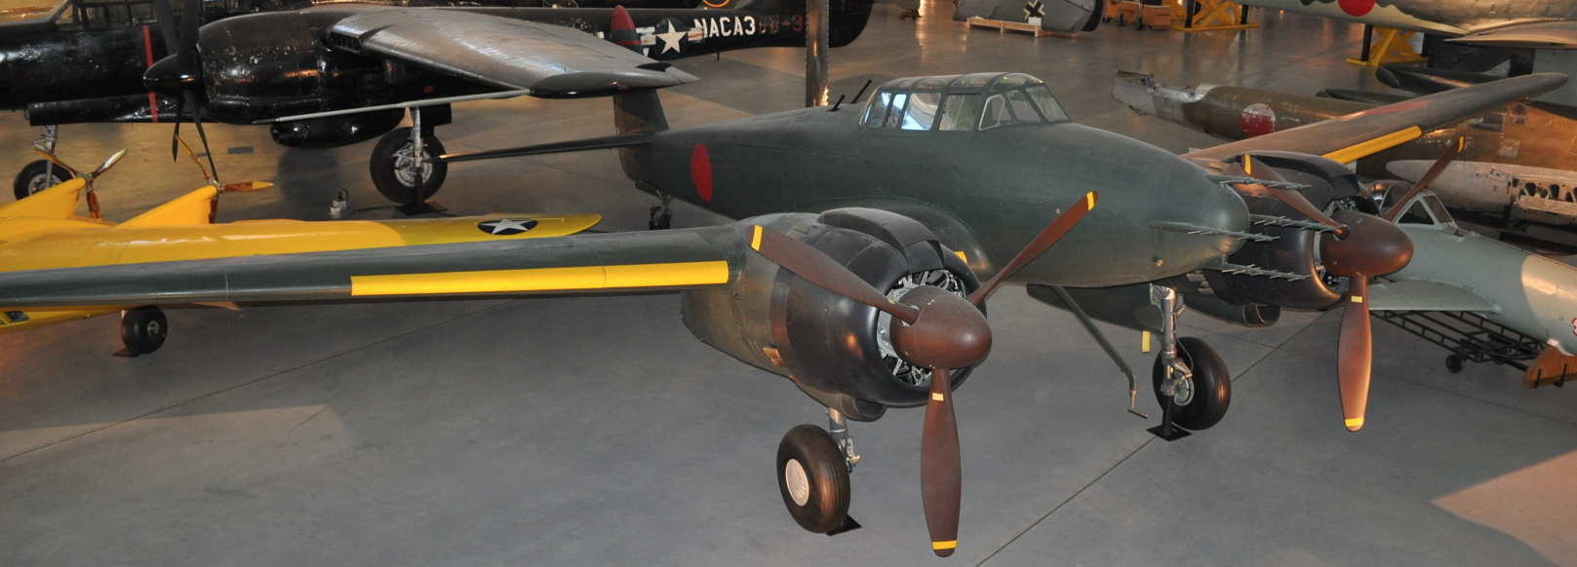
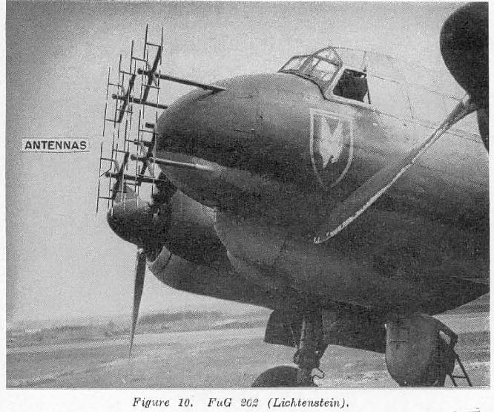
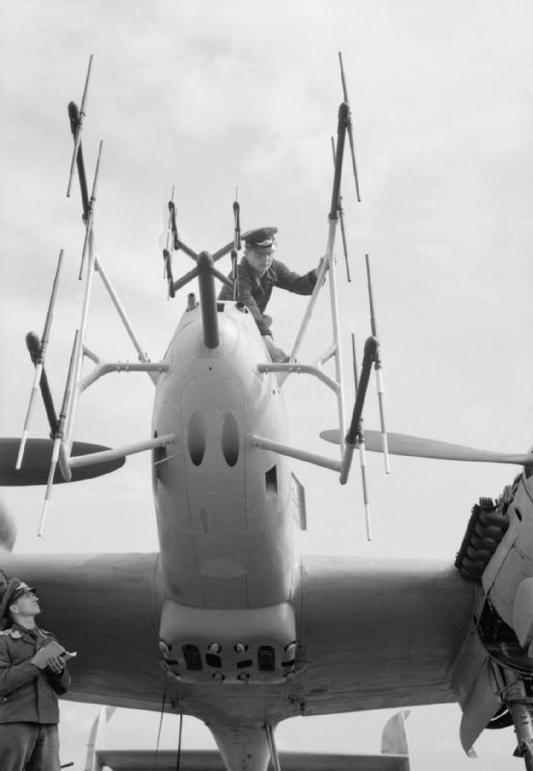
Airborne radars
Nakajima J1N1-S (Udvar-Hazy Center)

Slide 10
Battle of Midway
“It is impossible to plunge into war without a device which detects a target using electromagnetic waves … the plunge into war without a DENTAN is most thoughtless” – Rear Admiral Yanagimoto (who lost his life at Midway aboard his command, the carrier Soryu)
“DENTAN” is an abbreviation for a radio locator, i.e., RADAR
One Japanese author says that Midway was “an ambush” partly because of the longer-range radar of the Allies.

Slide 11
Postwar investigation and 1991 paper
Rumored “Newmann Note”
Search for the note
English-to-Japanese translation difficulties
“Search Light Control” documentation
Gentei Sato, IEEE Antennas and Propagation Magazine, Vol 33, No. 3, June 1991

Slide 12
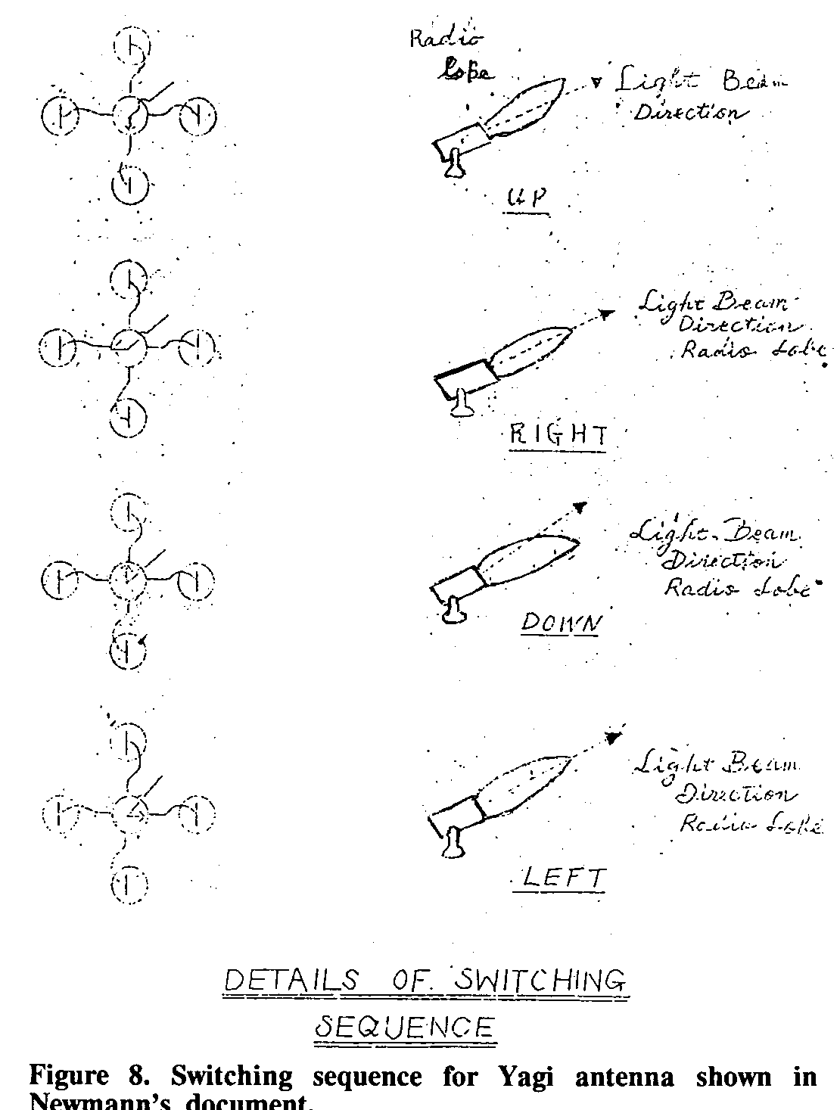
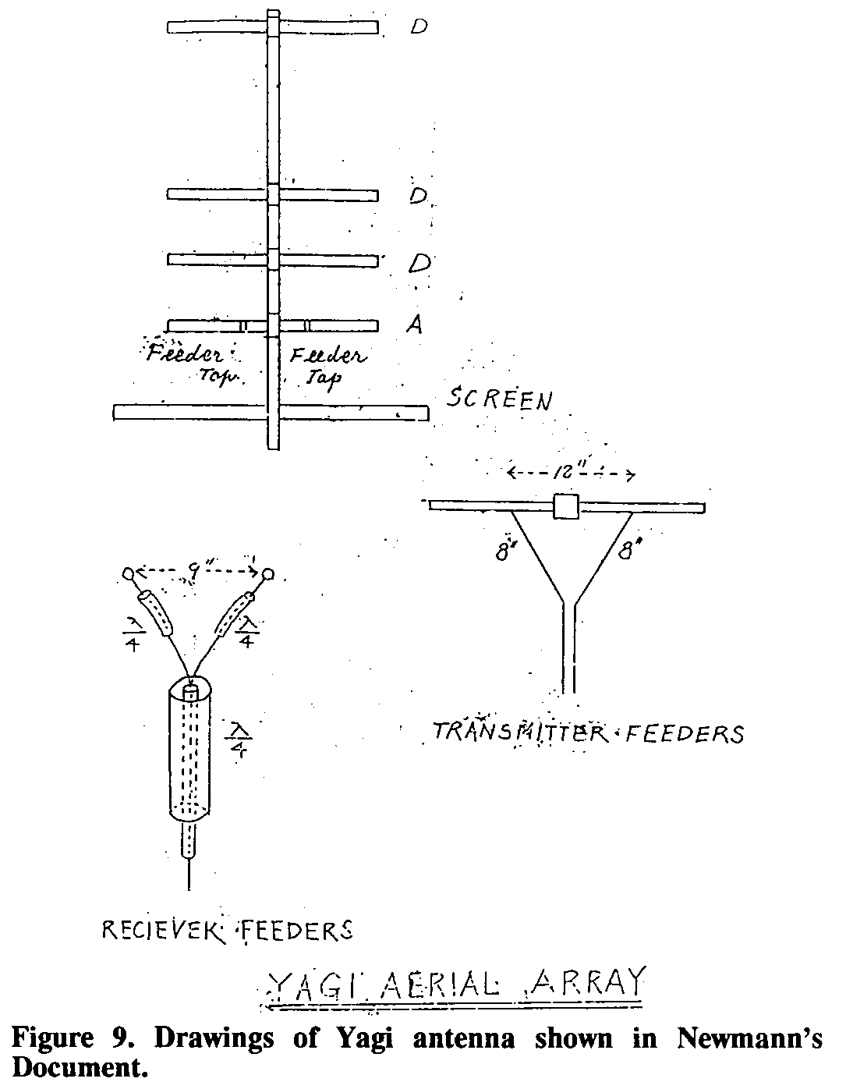
Newmann’s Note
A British radar operator named Newmann was captured in 1942 at the fall of Singapore, with notes describing “YAGI ARRAY”.
His interrogators did not understand the translation.

Slide 13
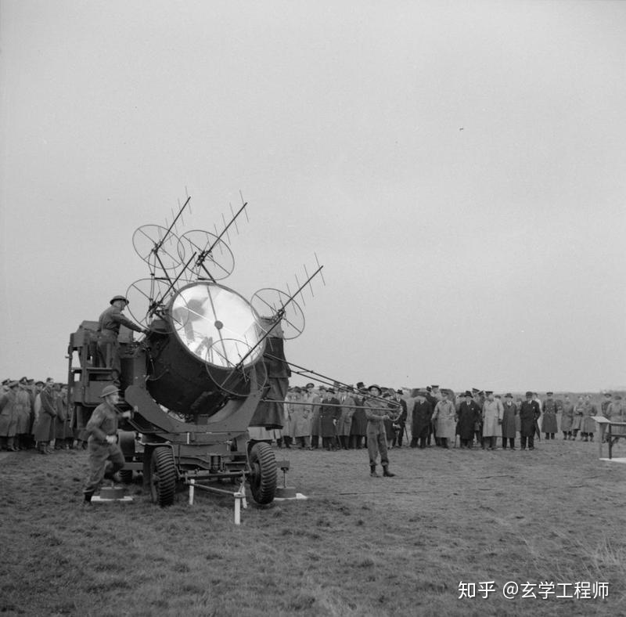
British Army demonstrates searchlight control with radar assist
This is the system that Newmann was trained on
The Japanese-language caption is a postwar addition.

Slide 14
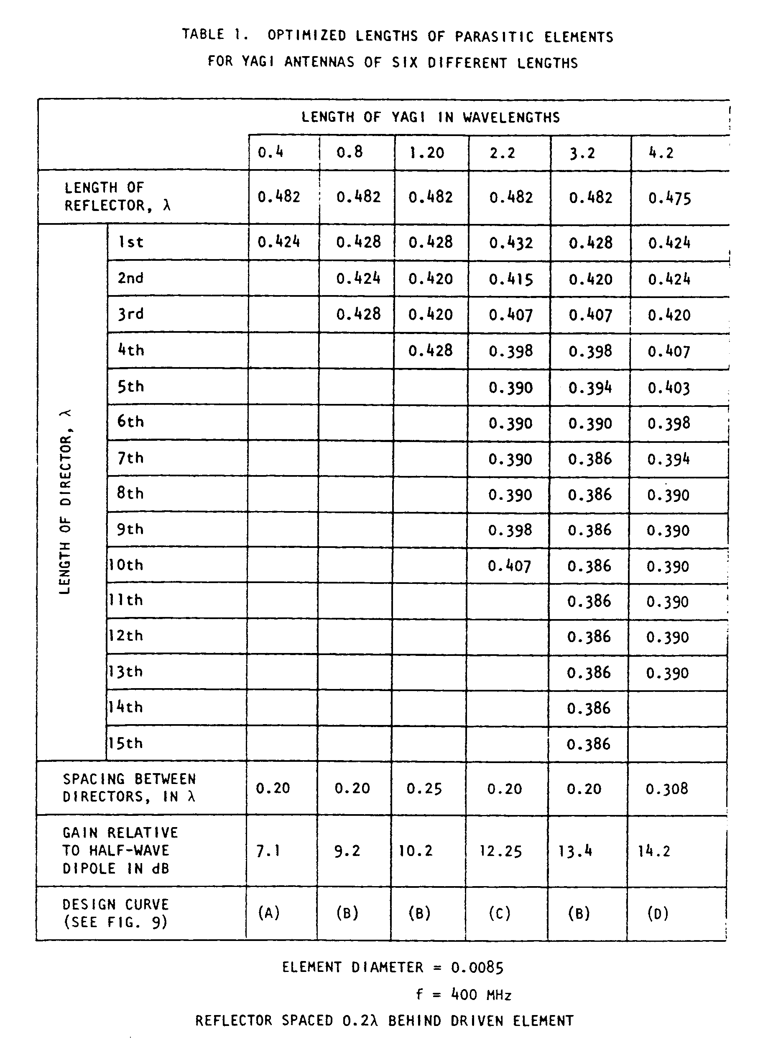
1977 NBS (now NIST) study
Peter P. Viezbicke, NBS TN 688, “Yagi Antenna Design”
Experimental data, obtained on the antenna ranges at Sterling, VA., and at Table Mountain, CO.
Examined the effects of different structural characteristics on gain and radiation pattern
  Square element vs round
  Reflector and director spacing
  Element diameter
  Size of boom
  Stacking
  Length of antenna vs radiation pattern

Slide 15
How does it work?
It is an array antenna
The sizes and positions of the array elements affect the shape of the radiation pattern

Slide 16
Yagi antenna is a Parasitic Array
One driven element, usually a dipole or a folded dipole
One or more parasitic elements, usually shaped like dipoles
  Reflectors
  Directors
  Not electrically connected to the driven element
  They manipulate the shape of the array’s radiation pattern, as will any conductor inserted in the antenna’s near field.

Slide 17
Starting assumptions
The plots you see are modeled in free space. The real world (which can also be modeled) will always affect the shape of the plot.
The plots are calculated with various spacing of directors.

Slide 18
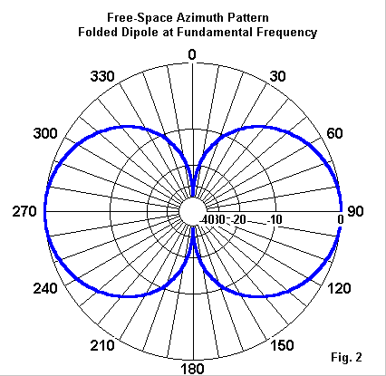
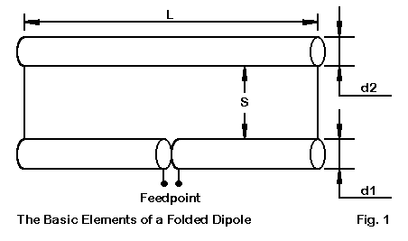
Start with the basics
The driven element is usually a dipole or a folded dipole.

Slide 19
Reflection
Reflector is about 5% longer than the driven element, spaced about 1/8 wavelength behind
More reflectors can be placed around the driven element, in a cylindrical arrangement

Slide 20
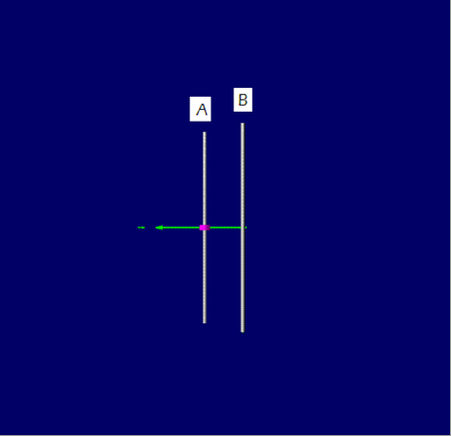
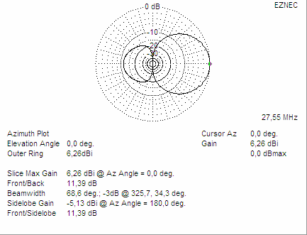
Driven element + Reflector

Slide 21
Directors
The first director is about 5% shorter than the driven element, and is placed about 1/8 wavelength in front of the driven element.
Each subsequent director is 5% shorter than the previous one, and is placed 1/8 wavelength in front.

Slide 22
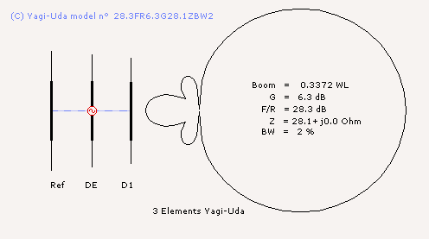
Driven element + Reflector + 1 Director

Slide 23
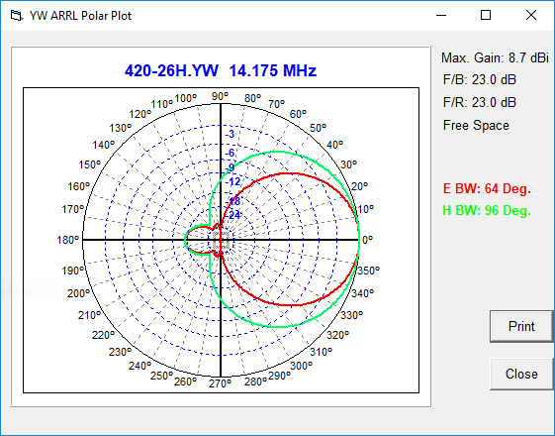
Driven element + Reflector + 2 Directors
At 0 degrees, gain is 8.7 dBi
Beamwidth 64 degrees
Front to back ratio is 23 dB
Boom is 25.5 ft long
FREE SPACE!

Slide 24
Variants
Stacked arrays of identical Yagi antennas
Dual-band and multi-band Yagi antennas are available
Crossed Yagi antennas have been used to generate circular polarization
Elements may be squares, rings, or triangles
Elements may be round or square tubing
Elements may be solid
“Quad” antennas are used at HF, with or without a director.
Elements may be flat metal plates
The boom may be any practical material
A “shower curtain” Yagi has been designed and tested (Leslie Eaton, K5LLE in Houston)

Slide 25
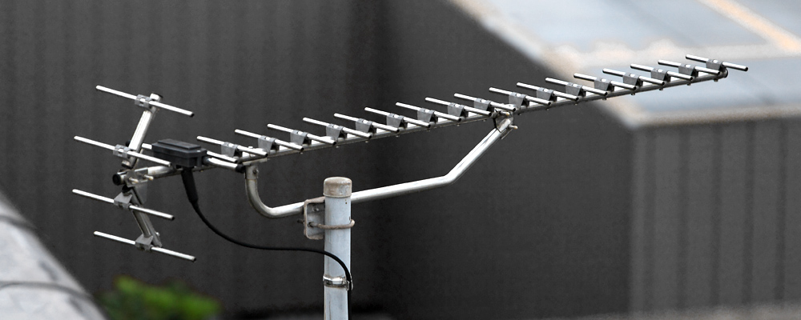
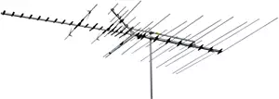
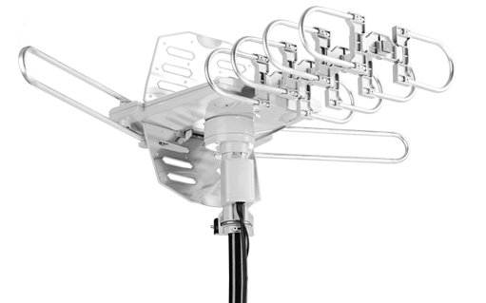
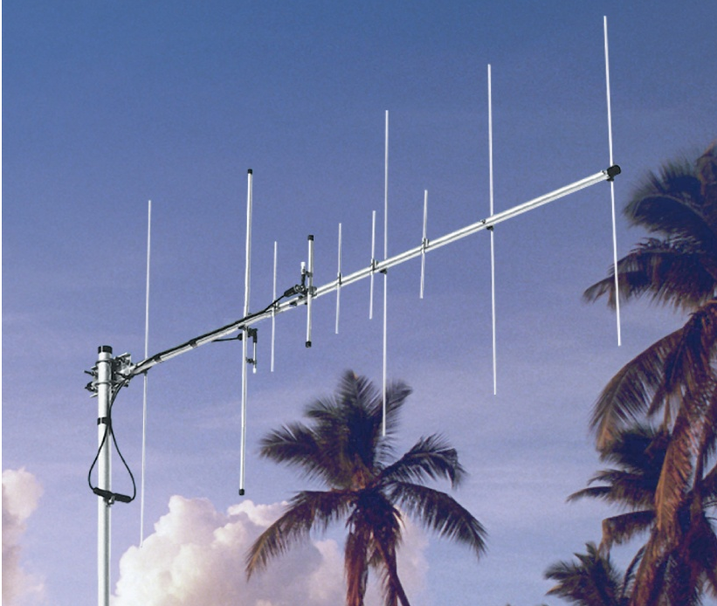
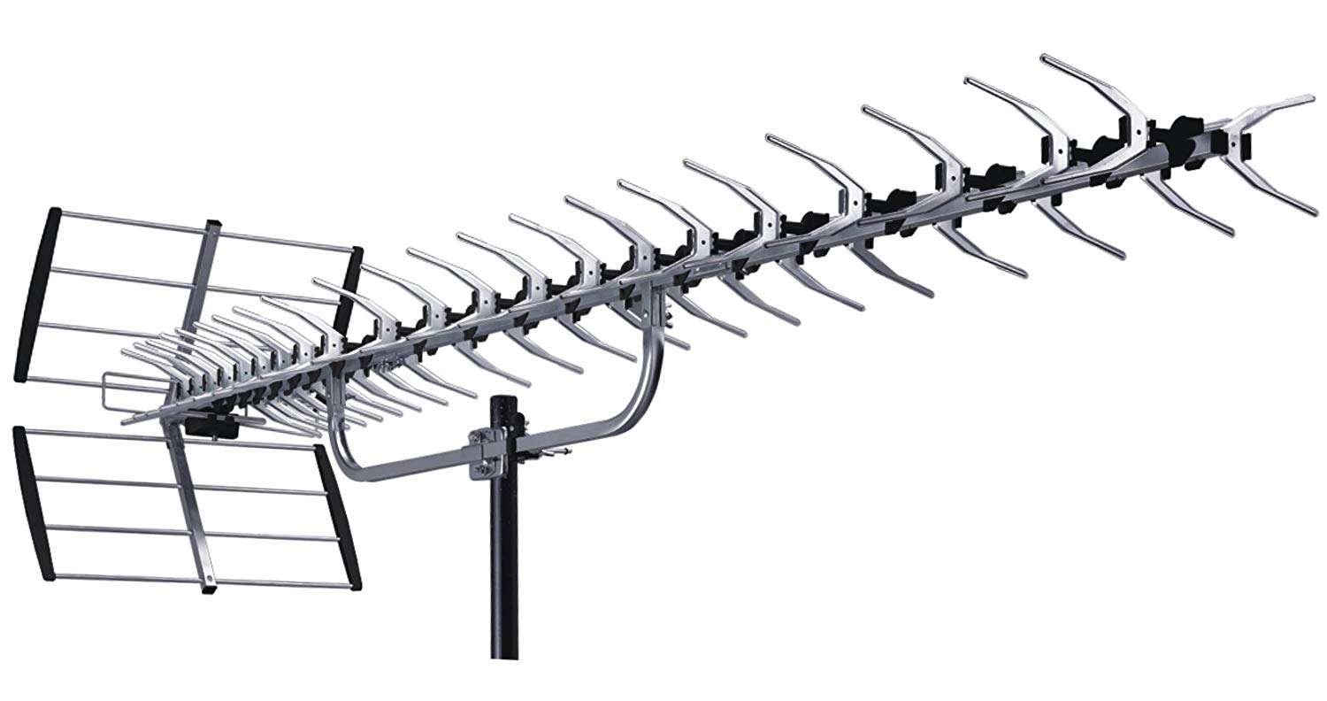
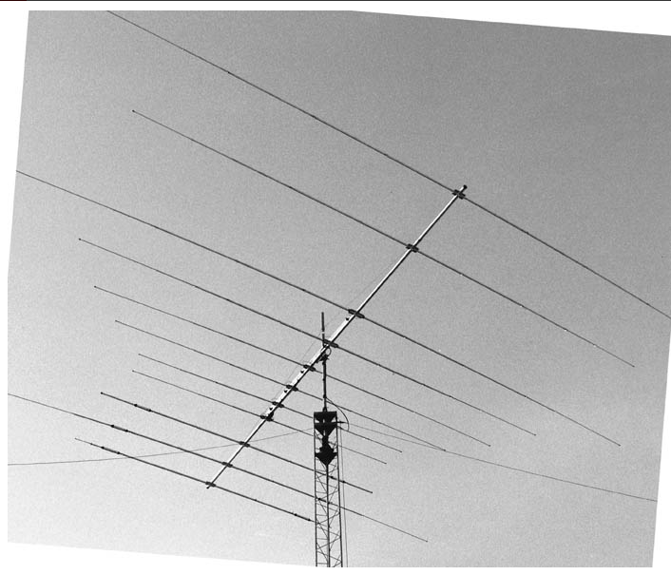
Lots of Yagi antennas

Slide 26
References
Wikipedia articles: “Yagi Antenna”, “Yagi”, “Uda”
ARRL Antenna Book 23rd Edition: “Chapter 11, The Yagi Antenna”
National Bureau of Standards Tech Note 688: “Yagi Antenna Design”
IEEE Transactions on Antennas and Propagation, June 1991 story about the “Newmann Note”
“Yagi Antenna Design” by Dr. James L. Lawson

Slide 27
Comment from NBS
Discussing Yagi’s IRE paper. “Beam transmission of ultra short waves”, Proc. IRE Vol 16, No. 6, June 1928, pp. 715-741.
“Prof. Yagi’s remarkable work stimulates thought of a radical order. I venture to suggest that before many years radio operations will generally be considered divided into two classes, broadcasting and directive radio … I have never listened to a paper that I felt so sure was destined to be a classic.” – J. Howard Dellinger, Chief of the Central Radio Propagation Laboratory.
Quoted in “Achievement in Radio” Oct 1986.

Slide 28
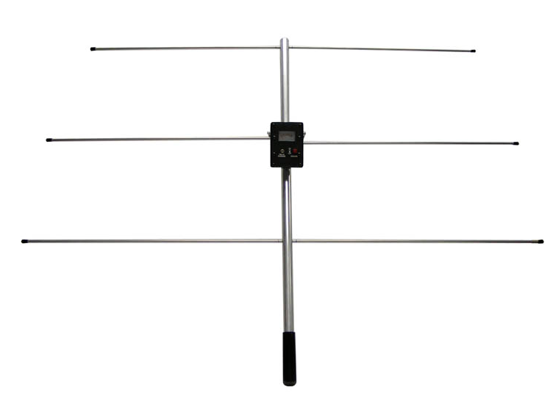
More than TV
Navigation aids for air travel (beacons, markers)
Communication links (school zone traffic signals)
Patch antennas for GPS (2-element!)
Satellite TV (not just a dish?)
Interference locator

Slide 29
Thank You!
IEEE Central Texas Section
IEEE Life Members Affinity Group, Austin
IEEE Communications Society
Wikipedia
YouTube
San Antonio Radio Club

Slide 30
Disclaimer
This is an informal paper.
I have attempted to give credit where it is due.
Any errors are probably my fault.
Suggestions and corrections may be sent to me at this e-mail address: t.p.obrien@ieee.org

